Slide 1
SW Programming Project
#3. (Implementation & Evaluation)

Slide 2
Criteria
To search the most appropriate file relevant to ‘keyword’, I think the ‘level of relevance’ is determined by how useful the files are.
And I design 4 criteria to generalize which file is most useful.
1. Is ‘file name’ include the keyword?
2. How many times the keyword appear in files.
3. Is the keyword distributed regularly in file?
4. How early the keyword appear.
+) How many words are meaningful.

Slide 3
+) Details
User can search the file by using keywords, regardless of upper or lower case. (Same as contents of file)
computer = CoMpuTEr
User can search the file by using ‘multiple keywords’ which contains white space, like “Personal communications” or “computer software”.
Program can separates the ‘meaningful word’.

Slide 4
+) Details
Meaningful Word.
=don’t place between exceptional character.
ex) keyword [me] in A[me]rica is meaningless.
( )[keyword]( ) - Highest weight.
( )[keyword](w) - 2nd …..
(w)[keyword]( ) - 3rd.....
(w)[keyword](w) - meaningless

Slide 5
Implementation
There are 3 functions played in regular sequence.
1. FindName – Find name that include keyword.
(for users who want to find files by ‘cord’ of news.)
2. GetFileList – Make a list of ‘keyword included File’
3. Ranking – Following criteria, assigning weight to each file,
sorting at descending power.

Slide 6
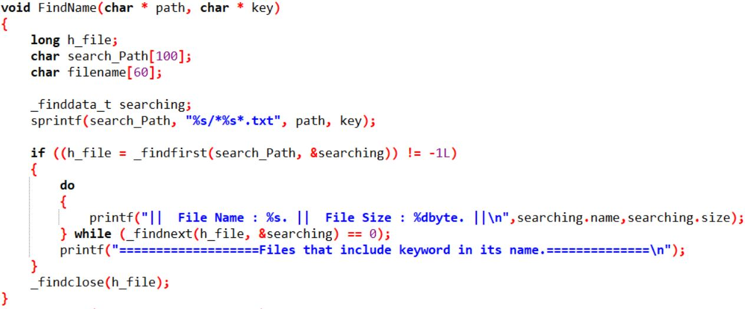
FindName()

Slide 7
FindName()
Usage function
struct _finddata_t : with _findnext, searching relative to keyword.
(struct vari).name : file name what above struct is searching now.
(struct vari).size : file’s size, which is used too at 2.GetFile()
It takes 0.011 sec (only find filename)

Slide 8
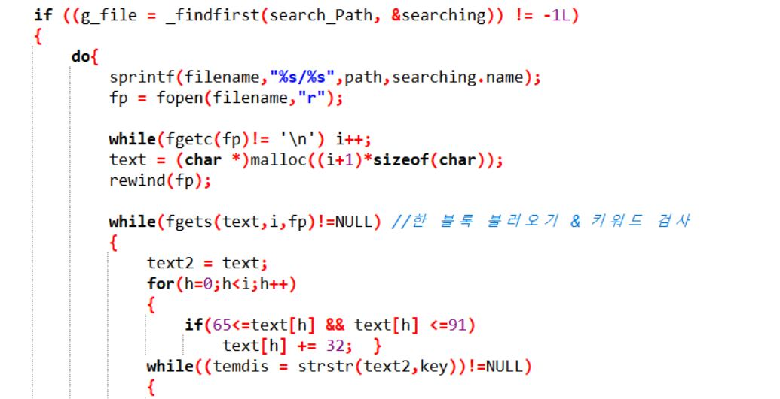
GetFile()
Using function
fgets() : bring many ‘block’ of each files. Block is separated by ‘\n’.
fgetc() : numbering the size of ‘block’, used at Dynamic allocation for fgets()
Upper case -> lower case
Transition ↓↓

Slide 9
GetFile()
Using function
strstr(str1,str2) : return position of first appearance of str2 in str1.
= used at 3.Ranking for ‘distance of keyword’.

Slide 10
GetFile()
At strstr() function, all character like -,@,!, ‘ ’(white space) are handled like one string.
So user can search by keyword that includes ‘not-alphabet-character’.
Using pointer variable returned by strstr(), algorithm knows what characters are at front and behind of keyword.
=> 3.Ranking()

Slide 11
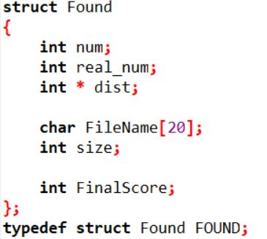
GetFile()
After listing all the files, proposition of file which would be used at Ranking algorithm are saved at FOUND struct.
Num : number of keyword in files
Real_num : number of ‘real number’ that apart from another word or character
Dist[] : distance between keywords in each files.
FinalScore : used at sorting

Slide 12
Ranking()
Priority
Number of keyword in file.
Score of ‘meaningful keyword’.
‘standard deviation’ = calculation summation of dist[].

Slide 13
Ranking
Weight
( )[keyword]( ) - 1
( )[keyword](w) - 0.8
(w)[keyword]( ) - 0.4
(w)[keyword](w) - 0.2
Ex) The file have 6,1,3,2 number of words in a file,
6*1 + 1*0.8 + 3*0.4 + 2*0.2 = 8.6

Slide 14
Ranking()
If two files have same integral, (8.2 and 8.5) calculate standard deviation of keyword.
(I’m consider deleting standard deviation because it takes too much memory and time but not so useful. )

Slide 15
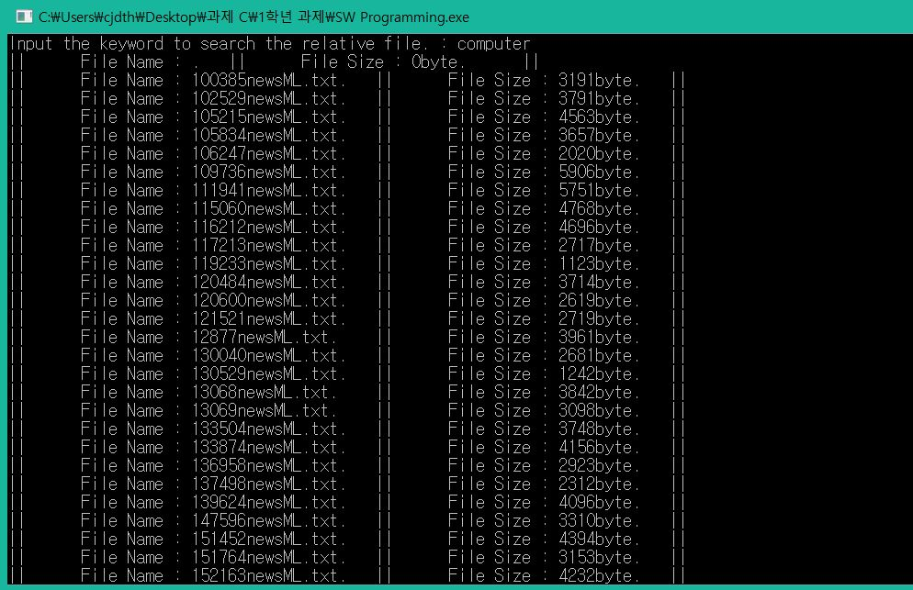
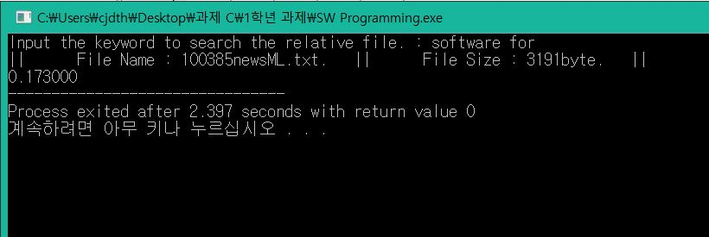
Implementation
This example doen’t include ranking algorithm because I reapairing it because of standard deviation
User can search multiple words.

